Slide 1

Encryption & Decryption using PYTHON

Slide 2
AGENDA:
Introduction
Cryptography
Working procedure
Advantages
Disadvantages

Slide 3
Introduction:
What is CRYPTOGRAPHY?
Cryptography or Cryptology, is the practice and study of techniques for secure Communication in the presence of Adversarial Behavior.

Slide 4

What is Encryption?
Encryption is the process of translating plain text data into something that appears to be random and meaningless (cipher text)

Slide 5

What is Decryption?
Decryption is the process of converting ciphertext back to plaintext.

Slide 6
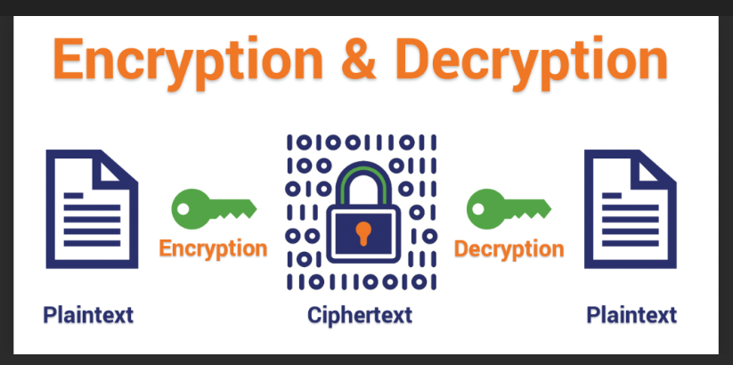

Slide 7
Working Procedure:
The user first enters the message
key and choose one of the encode or decode options. Based on the choice the corresponding operation is done.
It is to be noted that the same key used for encryption needs to be used during the decryption

Slide 8

Uses of this Tool:
1. You can send your personal messages and information with Privacy.
2. You can send secret message like (OTPs, Pins…etc)to your friends and Family with more Security
3. It helps secure sensitive information like login credentials like Username and Passwords

Slide 9
Disadvantages:
1. Key Management is one of the biggest challenges in the Encryption process.
2. There is a loss of physical storage Media.

Slide 10

BY::
S. Vijayakumari
A.V.Ganilakshmi

